Slide 1

Fundamental Concepts in Machine Learning Model Training (3)
Professor Bo Liu
James Watt School of Engineering

Slide 2

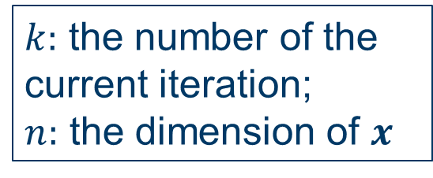
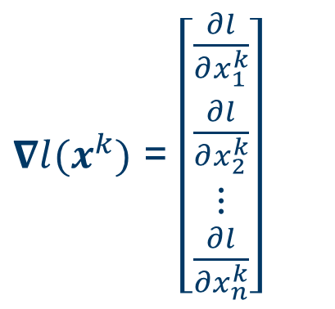
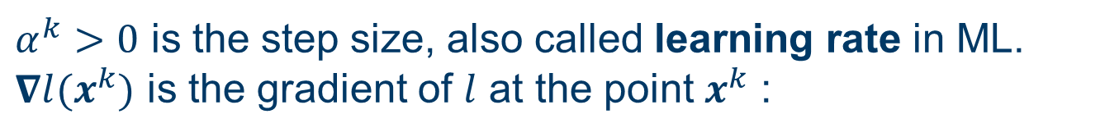
Minimize loss function: the gradient descent method (optional)
Gradient descent is a first-order iterative optimization algorithm for finding the local minima of a differentiable function.
Gradient descent iteration:
$x^{k+1}=x^{k}−α^{k}∇l(x^{k})$ (1)
$α^{k}>0$ is the step size, also called learning rate in ML.
$∇l(x^{k})$ is the gradient of $l$ at the point $x^{k}$ :
$∇l(x^{k})$ = $\left[\begin{aligned}\begin{matrix}\frac{∂l}{∂x_{1}^{k}} \\ \frac{∂l}{∂x_{2}^{k}} \\ ⋮\end{matrix} \\ \frac{∂l}{∂x_{n}^{k}}\end{aligned}\right]$
$k:$ the number of the current iteration;
$n:$ the dimension of $x$

Slide 3

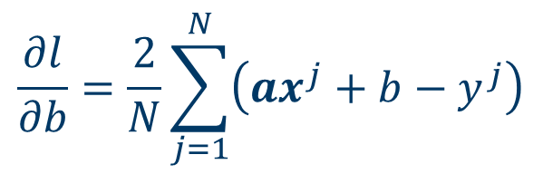
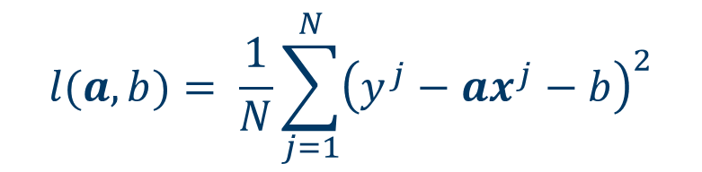
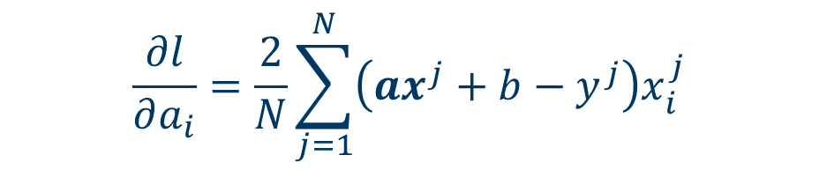
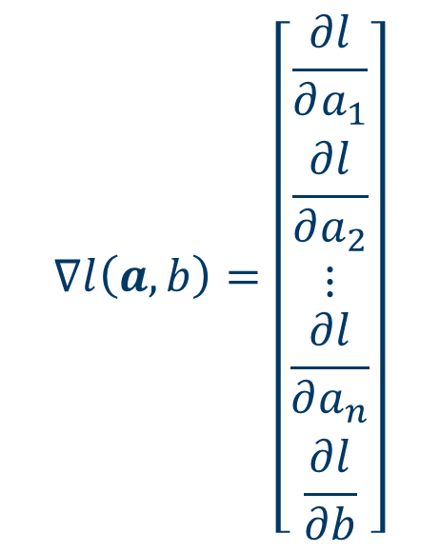
Linear regression: gradient descent (optional)
$$l(a,b)= \frac{1}{N}\sum_{j=1}^{N}{{\left(y^{j}−ax^{j}−b\right)}^{2}}$$
$$∇l\left(a,b\right)=\left[\begin{aligned}\begin{matrix}\frac{∂l}{∂a_{1}} \\ \frac{∂l}{∂a_{2}} \\ ⋮\end{matrix} \\ \frac{∂l}{∂a_{n}} \\ \frac{∂l}{∂b}\end{aligned}\right]$$
$$\frac{∂l}{∂a_{i}}=\frac{2}{N}\sum_{j=1}^{N}{\left(ax^{j}+b−y^{j}\right)x_{i}^{j}}$$
The gradient of $l\left(a,b\right)$:
$$\frac{∂l}{∂b}=\frac{2}{N}\sum_{j=1}^{N}{\left(ax^{j}+b−y^{j}\right)}$$
Given $∇l\left(a,b\right)$, $l(a,b)$ can be minimized by the gradient descent algorithm.

Slide 4
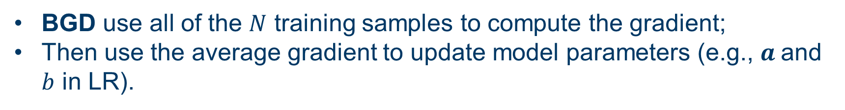
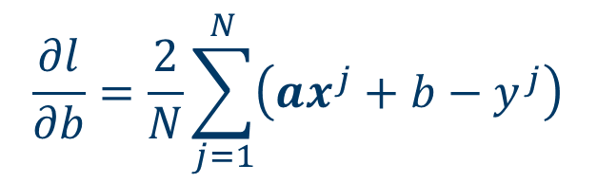
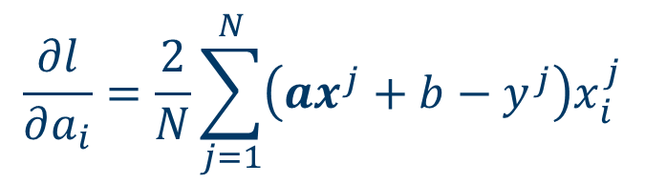
Batch gradient descent (BGD)
In gradient descent algorithm, we need to compute the gradient
$$\frac{∂l}{∂a_{i}}=\frac{2}{N}\sum_{j=1}^{N}{\left(ax^{j}+b−y^{j}\right)x_{i}^{j}}$$
$$\frac{∂l}{∂b}=\frac{2}{N}\sum_{j=1}^{N}{\left(ax^{j}+b−y^{j}\right)}$$
BGD use all of the $N$ training samples to compute the gradient;
Then use the average gradient to update model parameters (e.g., $a$and $b$ in LR).
Pros: its convergence is guaranteed.
Cons: lower exploration ability, high memory usage.

Slide 5
Stochastic gradient descent (SGD)
The iteration of SGD:
  Take a sample from the training set.
  Calculate its gradient.
  Update the model according to the gradient.
  Repeat a) to c) for all the samples in the training set.
Pros:
Less memory is required.
Stronger exploration ability.
Cons:
Frequent model updating, computationally expensive
Gradient is noisy, slow convergence.

Slide 6
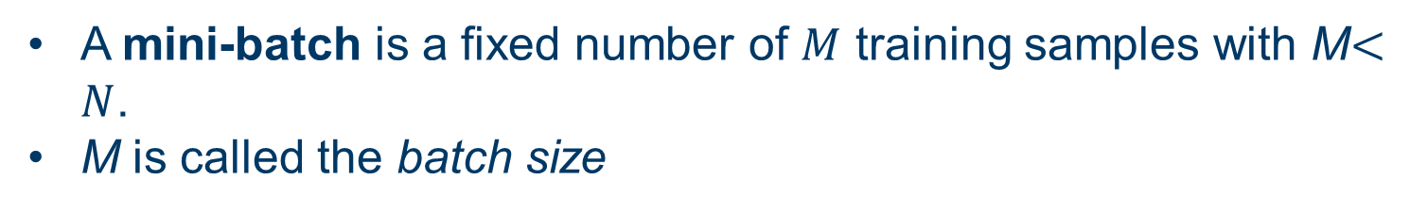
Mini-batch gradient descent (MBGD)
In BGD we use all samples at a time.
In SGD we use only one sample at a time.
In MBGD we use a mini-batch at a time.
A mini-batch is a fixed number of $M$ training samples with M$<N$.
M is called the batch size
MBGD:
  Split the dataset into a number of mini-batches.
  Take a mini-batch from the training set.
  Calculate mean gradient of the mini-batch.
  Update the model according to the mean gradient.
  Repeat b) to d) for all the batches.

Slide 7

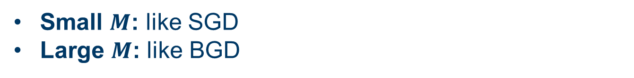
Mini-batch gradient descent (MBGD)
In MBGD, $M$ is a hyperparameter that affects the learning process.
Small $M$: like SGD
Large $M$: like BGD
A good default for $M$ is 32.
MBGD is a combination of BGD and SGD, so
  It can avoid converging to local minima to some extent.
  Less memory is required.
  Fast convergence.

Slide 8




Thanks!
#UofGWorldChangers
@UofGlasgow

